Slide 1
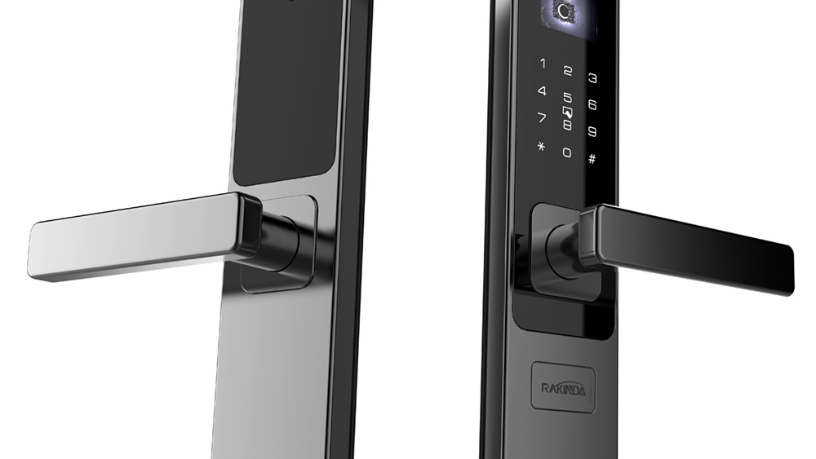
DOOR LOCK SYSTEM BASED ON QR CODE

Slide 2
PROBLEM STATEMENT
Safety is a basic requirement of every living being. Be it a safety of his belongings or safety of his own life. We have been taking several measures in order to attain it to live a worry free life.
Door locks are a common occurrence in our everyday lives. Traditional door locks they can be cracked easily by using some tools.
In this project an advanced security system is presented using QR Identification code, which is specially designed to be used in door locks.
The QR system presented here is a new methodology implemented to provide security services to hotel rooms along with better hospitality to guests (or) for homes.
This project aims to create a digital door lock system as a better alternative that accepts QR codes.

Slide 3


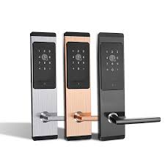

HIGH LEVEL REQUIREMENTS
OPEN CV4 (to run the code belongs to computer vision)
QR CODES
DATA BASE to save the key for door lock
CAMERA to scan the QR code.
NUMBER PAD to enter number lock (as an alternate for QR lock).

Slide 4
REQUIREMENTS:
FUNCTIOINAL | NON-FUNCTIOINAL
The system must allow the user to scan QR code | High-precision recognition, decoding only takes 2 seconds.
Decoding the QR code shown by user | The system should indicate the validity of a QR code with sound effects
Adding new QR keys(QR codes) | The operation of door lock is User friendly
An Alternate number lock will be available | It will be available 24/7
Verification of QR code is done by database | The data should be protected from unauthorized access

Slide 5
Risk Management:
Risk Management is the system of identifying, addressing and eliminating the problems before they can damage the project
Risk Identification
Damage of cam
Failure of working sound system
Door not open within 5 seconds.

Slide 6
MANAGING RISK 😎🤔
Risk Description | Impact Description | Action
If the cam does not work while showing QR code | The door remains closed even if the user shows the correct QR code. | Using numerical lock
If the sound system does not work | The user understands the door has not opened. | Replaced by using LED
Not opening the door within 5 seconds. | User thinks not to use the digital door locks. | Making the code more efficient
Hacking of door lock system | Has a high impact as anyone can use. | Data encryption

Slide 7

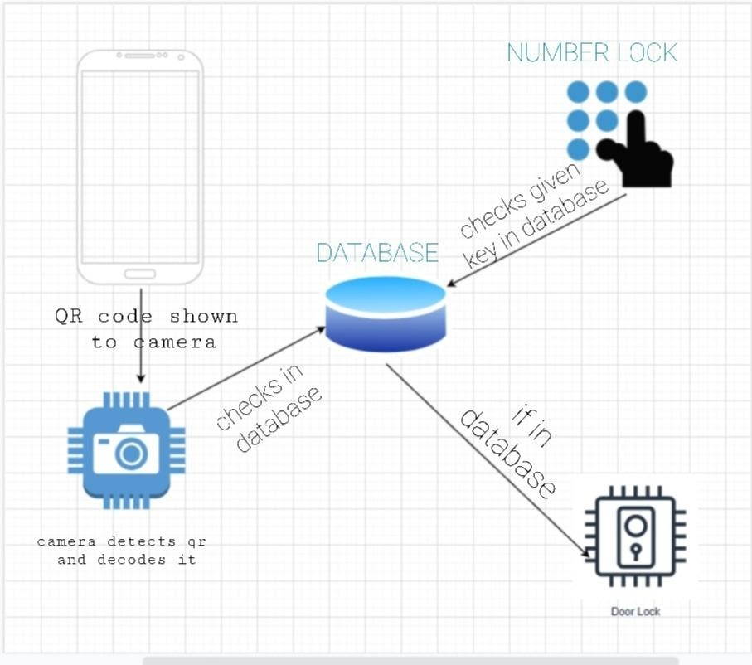
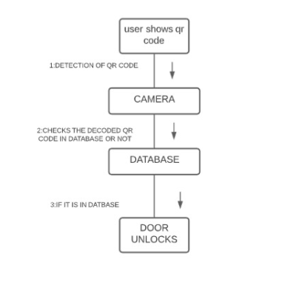

Architecture Diagram
Collaboration Diagram
The detection of QR code is done by showing the QR code through camera. Then checks whether the decoded code is in database or not. If it is in database then the door unlocks.
System architectural diagram consists of 5 components camera, database, door lock, number lock, QR code. Firstly, QR code is scanned with mobile using the Camera in the door. The scanned QR code will move to the database to get decoded. So, the door unlocks. As an alternative if the camera ruptures after years, a Keypad is also used. Users can unlock the door using a 4-digit pin. Even this moves to the database to decode and finally the door unlocks.

Slide 8
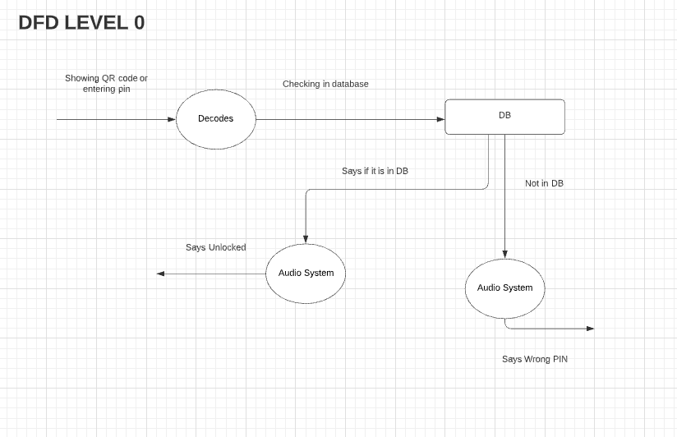
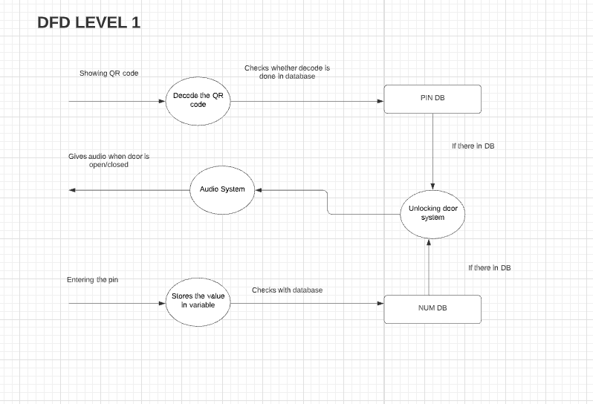
DFD Level 0 is also called a Context Diagram. It's a basic overview of the whole system or process being analysed or modelled. It's designed to be an at-a-glance view, showing the system as a single high-level process, with its relationship to external entities.
It has three major entities are of decoding, DB and audio system. When the user shows QR code or enters the pin it gets decoded and also checks in the database (DB) or not. If it is in DB, then it unlocks with sound. If not, the audio system doesn’t produce sound saying that entered pin or code is wrong.
A DFD LEVEL1 (Data flow diagram) of level-1 notates each of the main sub-processes that together form the complete system. It is the “exploded view” of the context diagram (DFD Level-0).
By showing the QR code it gets decoded and checks whether it is in database or not. If it is in DB door unlocks with beep sound. Alternatively, by entering the 4-digited pin it gets stores in a variable then checks whether in database or not. Similarly, door unlocks with beep sound if it is in database.

Slide 9
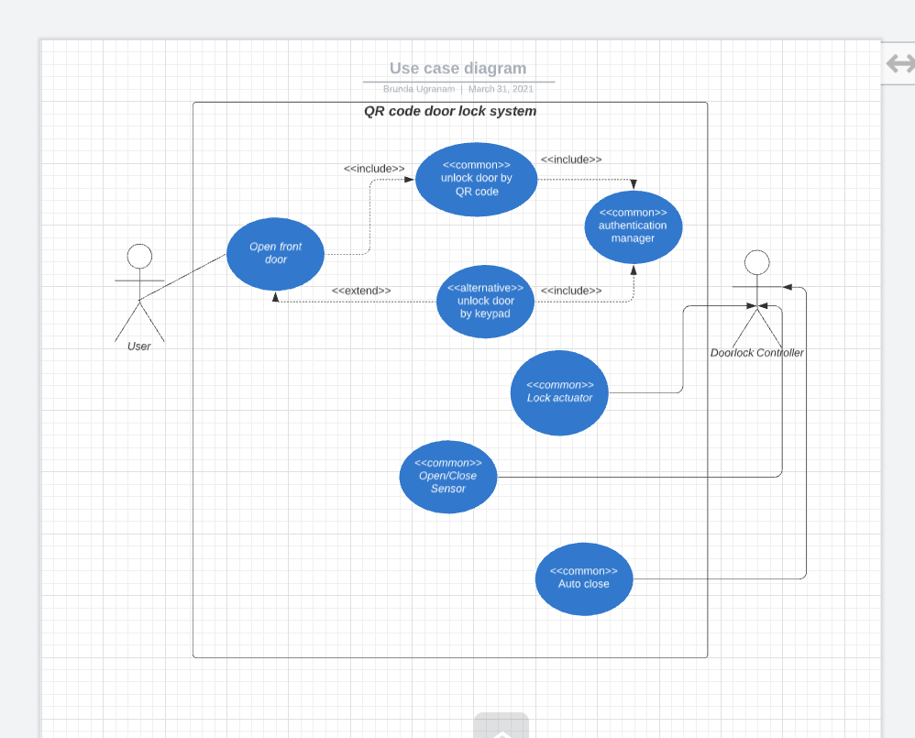
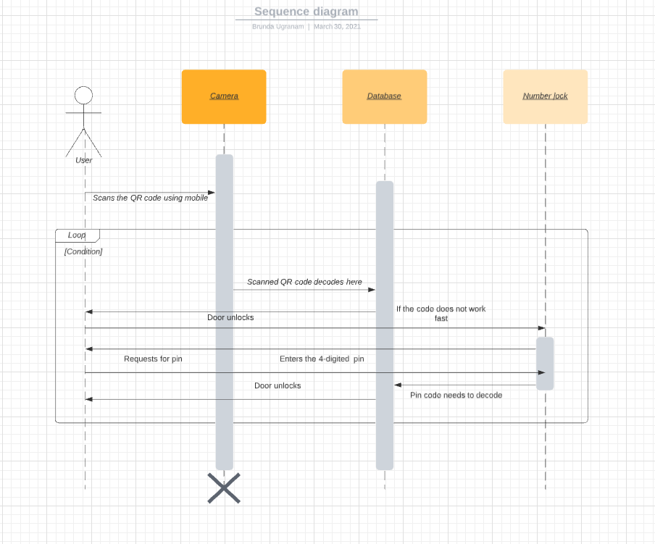
SEQUENCE DIAGRAM
A sequence diagram shows object interactions arranged in time sequence. The major objects involved here are camera, database and a number lock. User scans the QR code from mobile through the camera. In database, the code gets decoded and door unlocks. As an alternative, it has a number lock it requests for pin. User enters the 4-digited pin then pin gets decoded in database. Finally, door unlocks.
Use case diagram
A use case diagram at its simplest is a representation of a user's interaction with the system that shows the relationship between the user and the different use cases in which the user is involved.
The user unlocks door by entering pin or by showing QR codes which links up with the authentication manager.

Slide 10
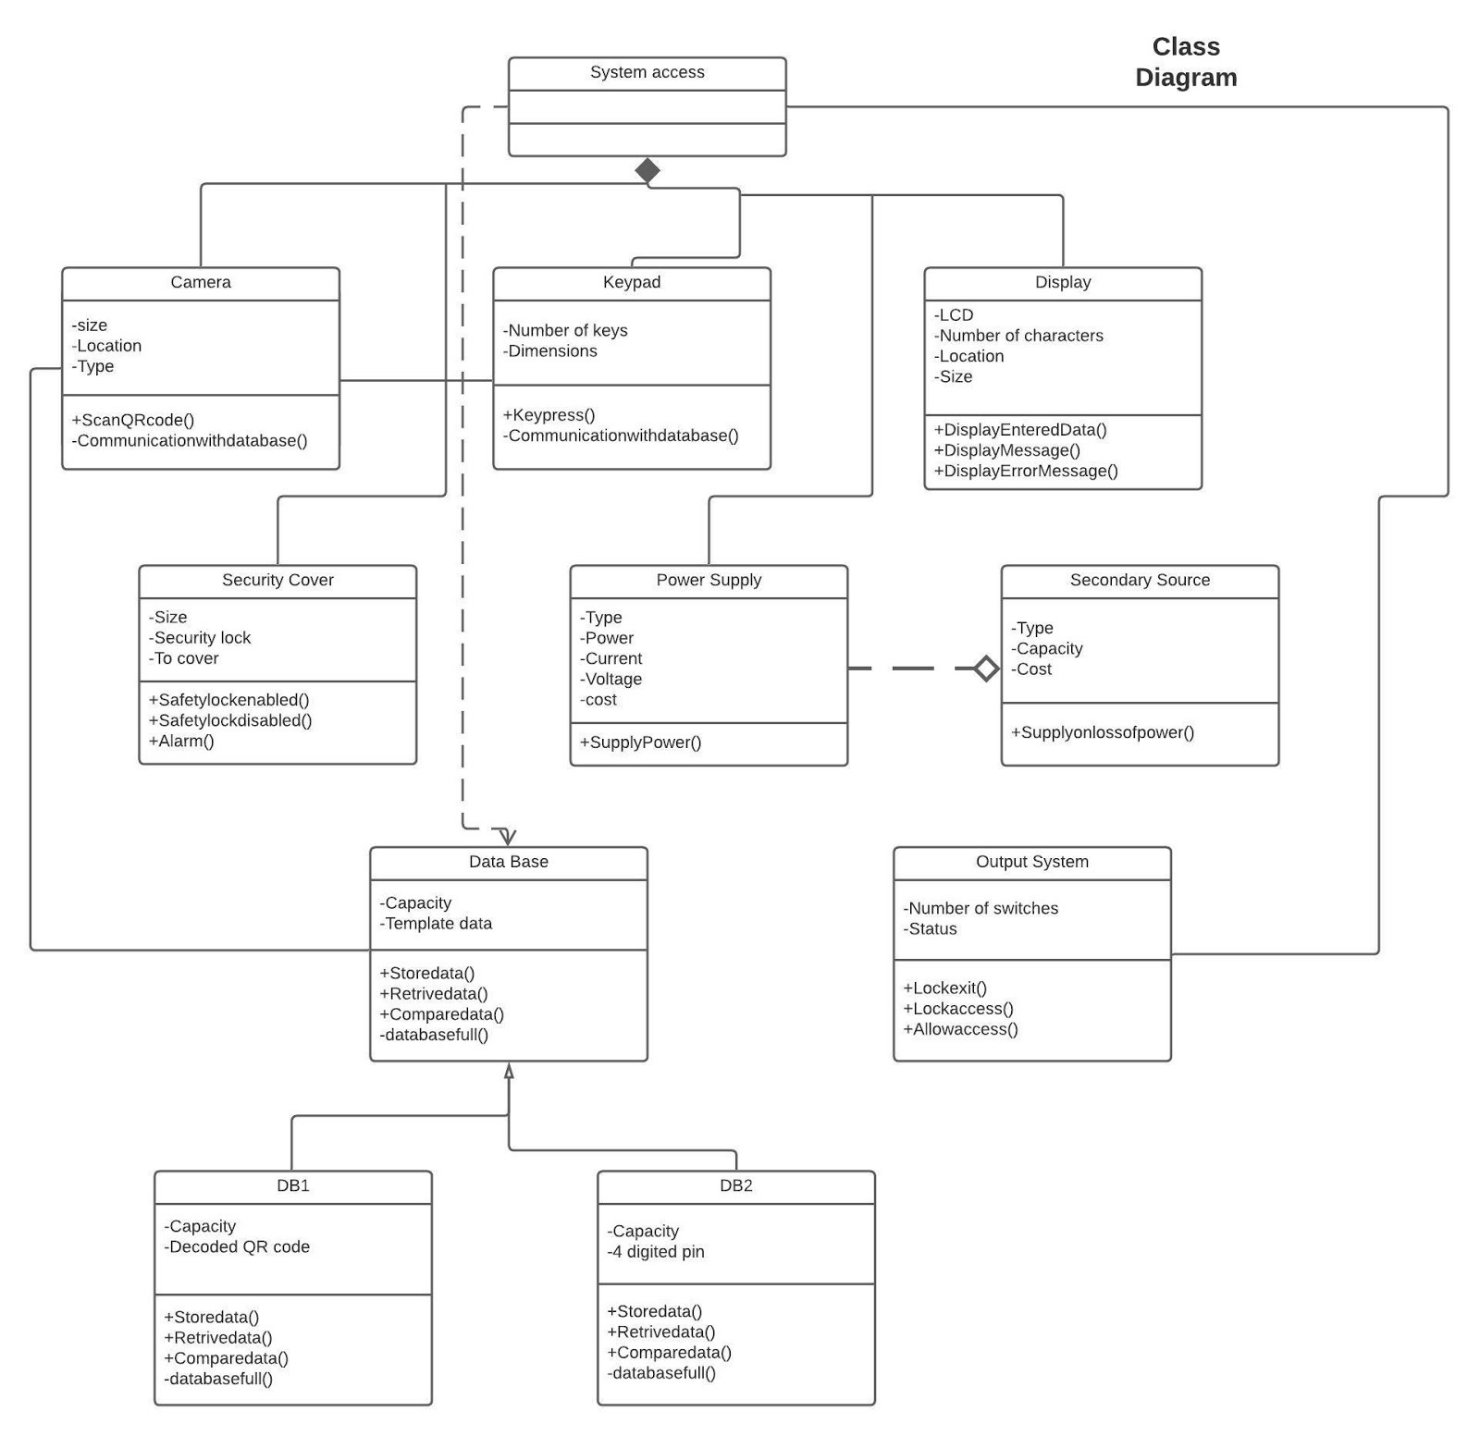
CLASS DIAGRAM
In software engineering, a class diagram in the Unified Modeling Language(UML) is a type of static structure diagram that describes the structure of a system by showing the system's classes, their attributes, operations (or methods), and the relationships among objects.
In a door lock system using QR code, we have classes such as camera, keypad, power supply, security, database, display, secondary source and an output system. Each class has a particular attribute in order to perform the specific operations.

Slide 11
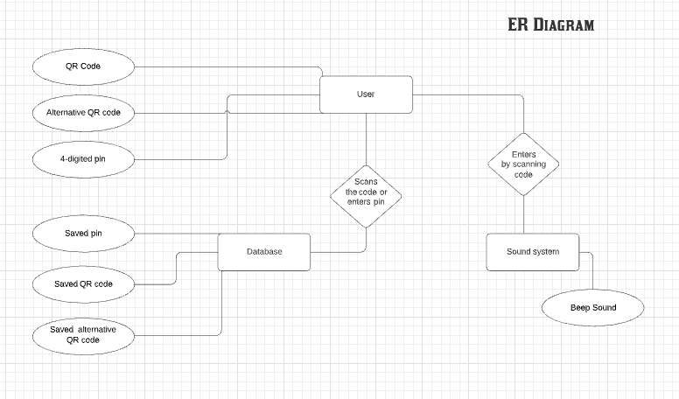
ER Diagram
An Entity Relationship (ER) Diagram is a type of flowchart that illustrates how “entities” such as people, objects or concepts relate to each other within a system. ER Diagrams are most often used to design or debug relational databases in the fields of software engineering, business information systems, education and research.
Door lock system using QR code has an entity of QR code, alternative QR code and a 4-digit pin functioned by the user. When the user scans the QR code it moves to the database. The entities in the database are saved QR code, saved alternative QR code and a saved 4-digit pin. As soon as it gets decoded, an entity beep sound is produced from the sound system when the door is open or closed.

Slide 12
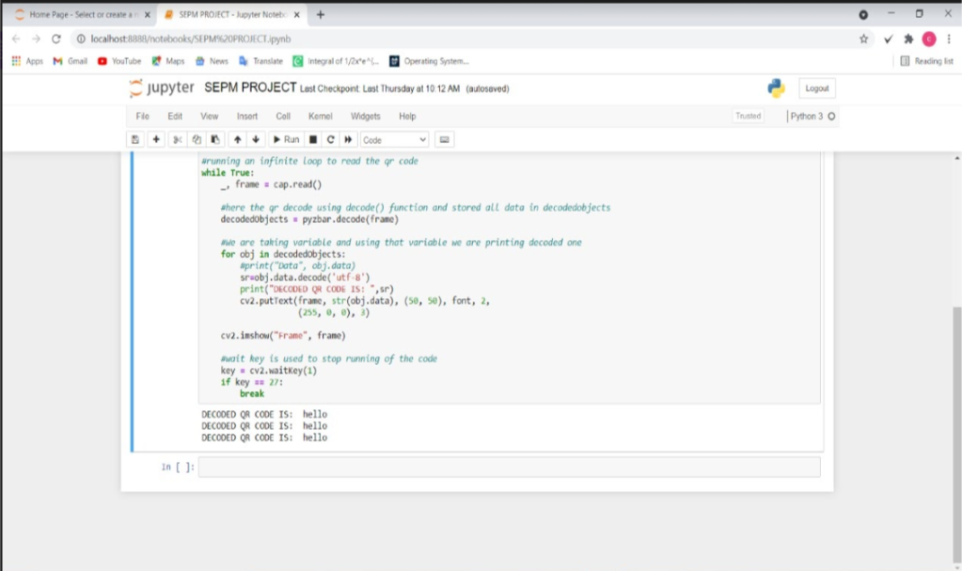
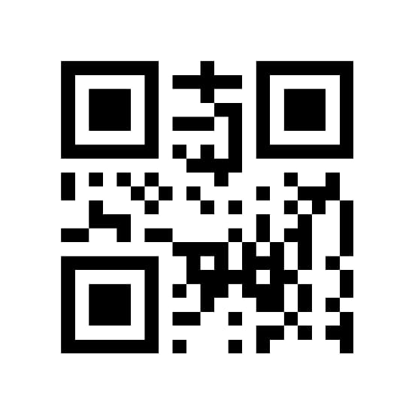
Demo module1:
The module1 fully covers decoding of QR code shown by user

Slide 13
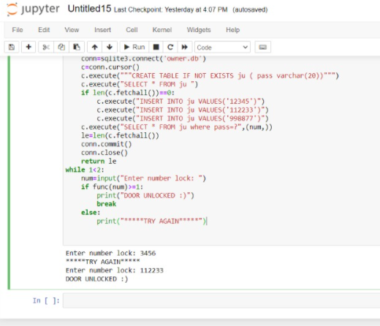
Demo module2:
This module 2 is about unlocking the door using number lock alternate for QR lock. When user enters correct number lock door unlocks by searching entered lock in database.

Slide 14
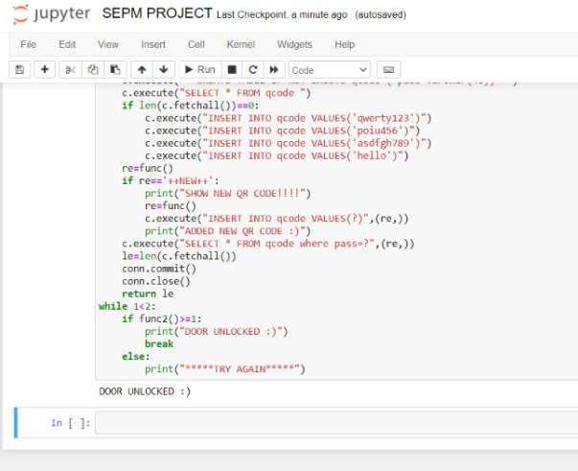
Demo module3:
The above code is the output for the decoded QR code. To add a new QR code the procedure is as follows.
This module 3 is about adding a new QR code as lock and unlocking the door. And in this module there will be a separate QR code when we show that QR it will accept the new QR into database.

Slide 15
Test cases:
S.NO | TEST CASE | RESULT
1 | QR code shown by user is already in database | Pops out message as "DOOR UNLOCKED :)"
2 | QR code shown by user is NOT in database | Pops out message as "*****TRY AGAIN*****"
3 | User enters number lock is in database | Pops out message as "DOOR UNLOCKED :)"
4 | User enters number lock is NOT in database | Pops out message as "*****TRY AGAIN*****" And asks for enter number lock
5 | Adding a new QR code with access QR code | Pops out message as "SHOW NEW QR CODE!!!!!" And after showing new QR Pops out message as "ADDED NEW QR CODE :)"
6 | Adding a new QR code without access QR code | Pops out message as "*****TRY AGAIN*****"

Slide 16




THANK YOU

